Slide 1

Netflix Content Trends Analysis
UDDIP BISHT
INTERNSHIP_17546440516895be537820f

Slide 2

PROBLEM STATEMENT
Netflix operates in a highly competitive global market, facing pressure from platforms like Amazon Prime, Disney+, and various regional providers.
To maintain its leadership, Netflix must move beyond intuition and leverage data to understand its vast content library.
The core problem is the need to identify strategic strengths, uncover hidden content gaps, and recognize new opportunities by analyzing historical content trends.

Slide 3
Project Description
This project is a data analysis initiative designed to dissect the evolution of the Netflix content catalog.
It investigates key trends by analyzing the distribution of Movies vs. TV Shows, the rise and fall of genres, and the geographical diversity of country contributions.
The ultimate goal is to translate these analytical findings into actionable, strategic recommendations that can guide future content acquisition and production decisions.

Slide 4

WHO ARE THE END USERS?
Netflix Content Strategy & Acquisition Teams: To make informed, data-driven decisions on what content to license or produce next.
Executive Leadership & Business Decision-Makers: To understand market positioning, allocate budgets effectively, and guide long-term strategy.
Content Producers & Regional Partners: To align their content proposals with Netflix’s strategic focus and identify partnership opportunities.
Market Analysts & Researchers: To study trends in the global media and entertainment industry.

Slide 5

Technology Used
Python: The core programming language used for all data processing and analysis.
Pandas & NumPy: For efficient data manipulation, cleaning, and transformation.
Matplotlib & Seaborn: For creating insightful and clear data visualizations (charts and graphs).
Jupyter Notebook: As the interactive development environment for writing code, visualizing data, and documenting the analysis process.

Slide 6
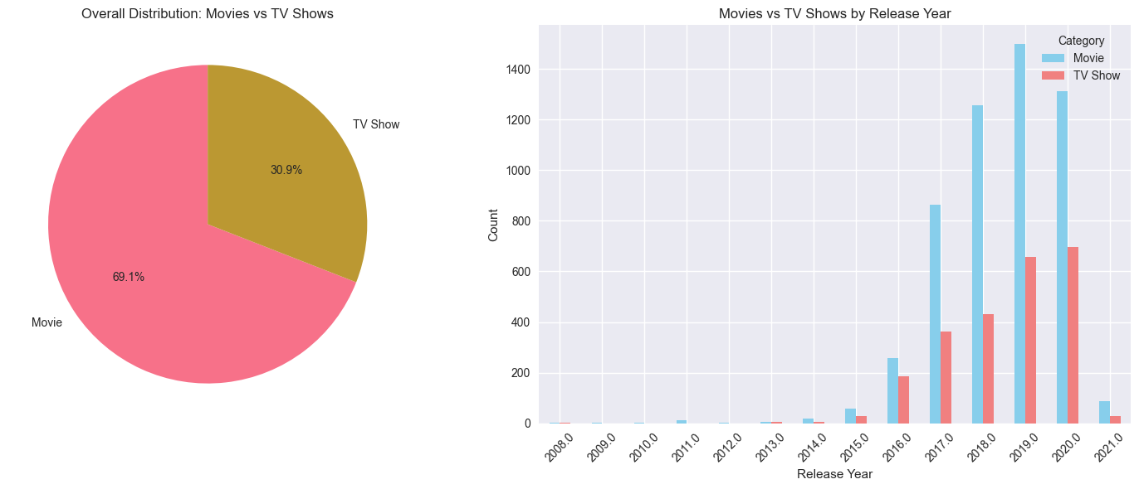
RESULTS1

Slide 7
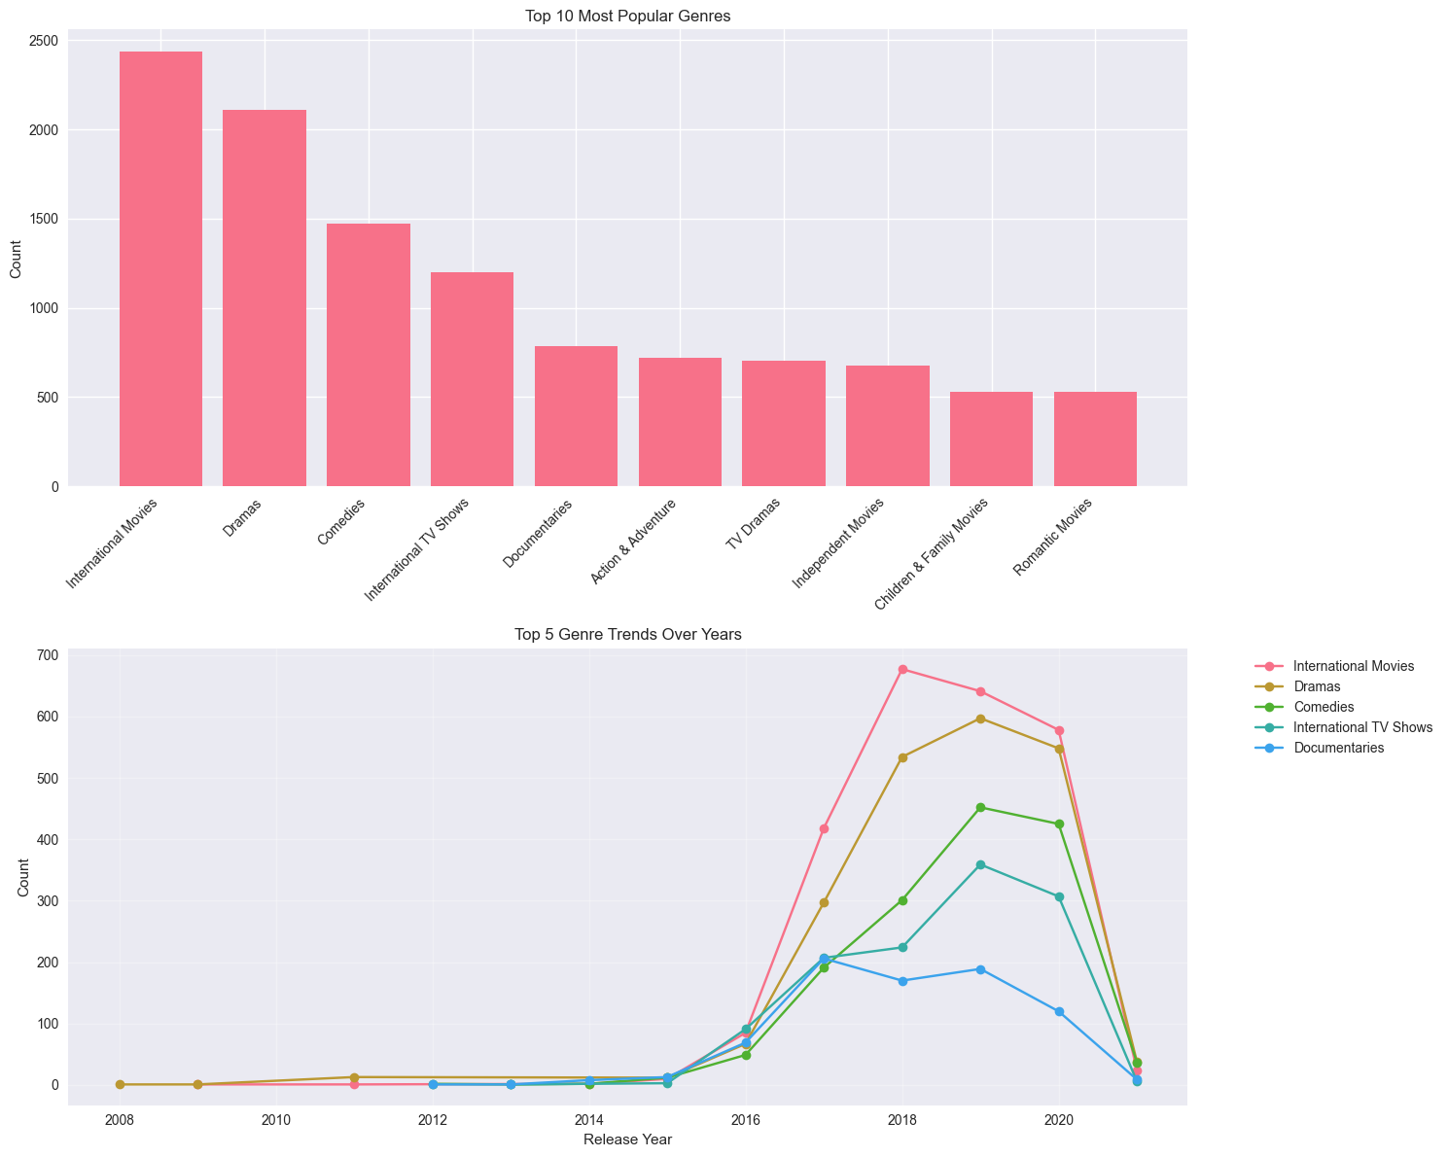
RESULTS2

Slide 8
RESULTS3

Slide 9
GitHub repository
https://github.com/uddipbisht/VOIS_AICTE_Oct2025_MajorProject_UddipBisht.git

Slide 10
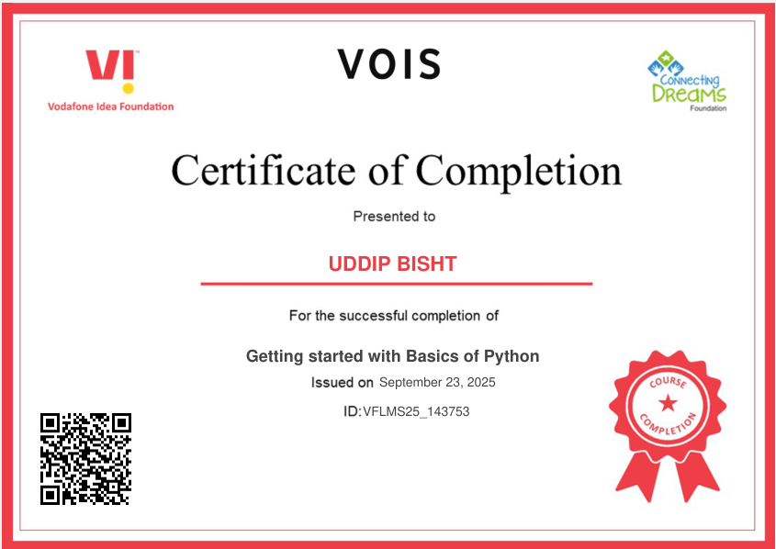
Getting started with Basics of Python Certificate

Slide 11
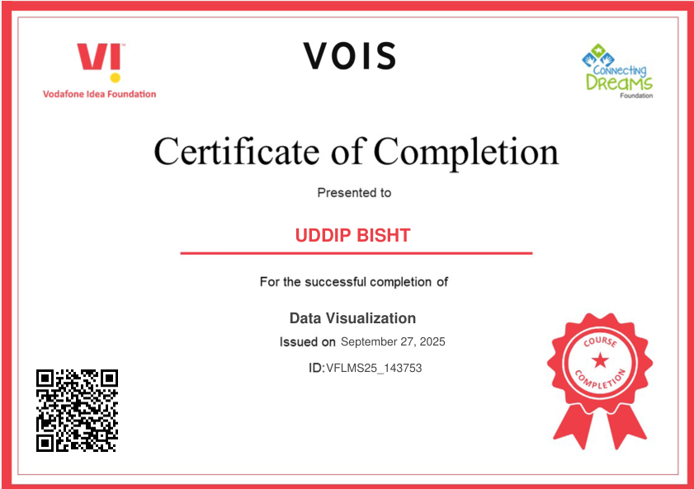
Data Visualization Certificate

Slide 12
Thank you
I’m thankful for the opportunity to work on this project, which helped me enhance my analytical and technical skills.
.
.

